Slide 1
Project Name:Unveiling Automobile Sales Trends
Student Name:Saini.Sandhyarani
Mentor Name: Sharayoo Dixit

Slide 2
Introduction of the Project
The "Unveiling Automobile Sales Trends" project aims to provide an in-depth analysis of current and emerging trends in the automobile sales sector. Through a comprehensive study of historical data, market dynamics, and consumer behaviors, this project seeks to identify key patterns, predict future developments, and uncover the driving forces behind the changing landscape of automobile sales.to identify temporal trends and understand the impact of variables like productline,deal size, and customer demographics on sales,analyze customer purchasing behavior patterns , segment customers accordingly and devise tailored marketing strategies. Ultimately, this project will serve as a strategic resource for stakeholders in the automobile industry, enabling them to make data-driven decisions, forecast market movements, and align their business strategies with the evolving demands of consumers and regulatory environments.

Slide 3
OBJECTIVES
Conduct an exploratory data analysis utilizing Tableau’s visualization capabilities and dashboards to delive into the sales data of miniature automobiles that are sought after by hobbyists and collectors all over the world.
Extrcat actionable insights from the provided data,focusing on key areas such as sales analusis,customer segmentation,product performance, etc….
To analyze sales performance,customer segmentation, sales forecast,and product performance over the specified period,followed by summarizing the key findings.

Slide 4
Over all Business Conclusion
Unveiling Automobile Sales Trends:
Project Part1:In part1,we conducted an analysis of sales data for miniature automobiles,concentrating on sales performance over time,customer segmentation ,sales forecast,and product performance…..
Project Part2:In this part2,our objective is to take additional business inquiries related to inventory management ,order fulfillment analysis, and pricing strategy…..

Slide 5
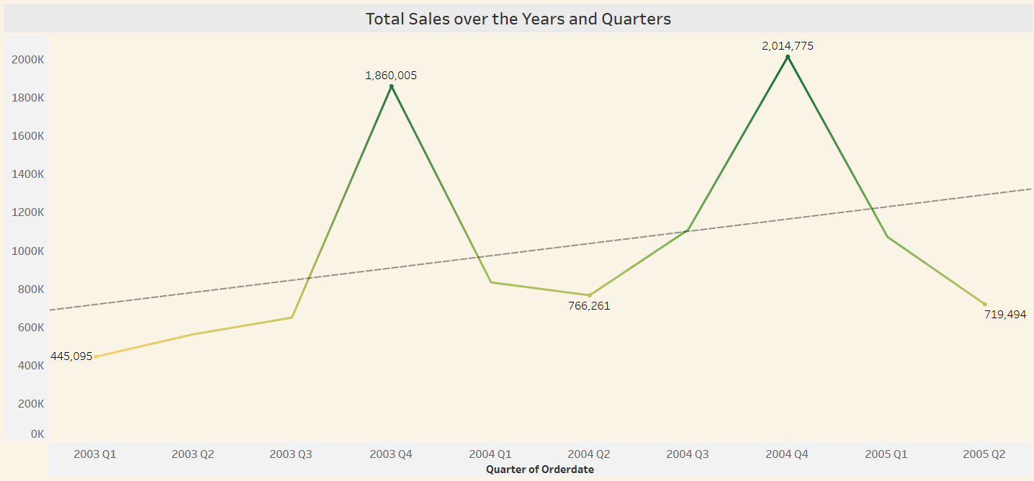
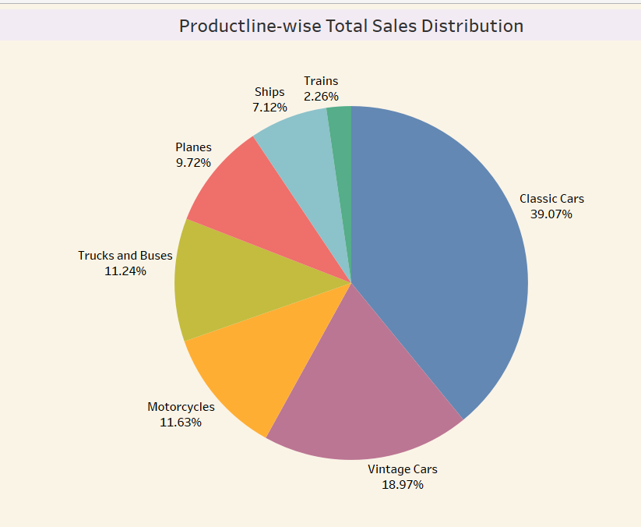
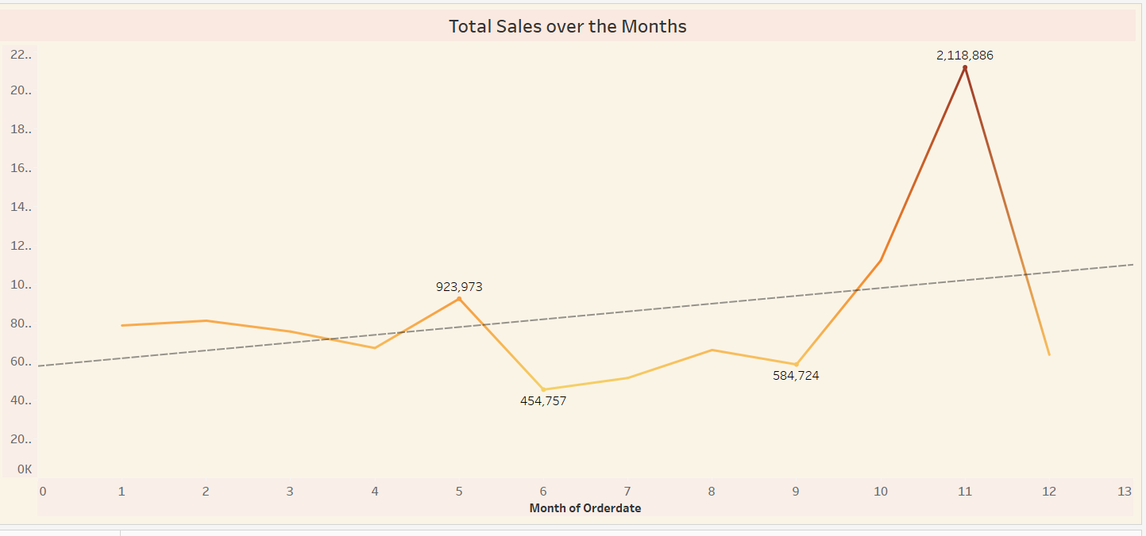
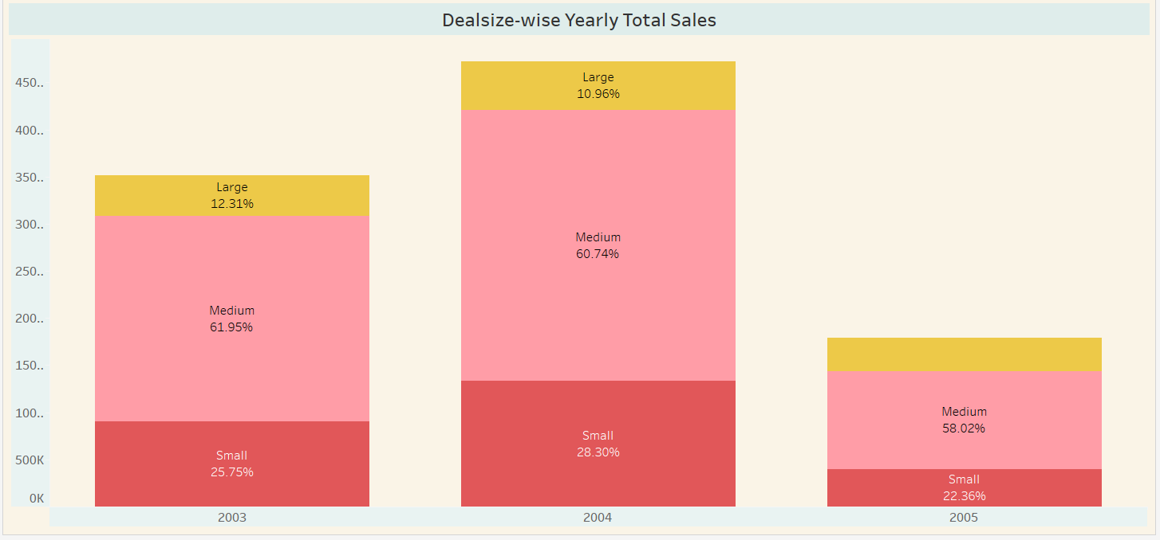
Sales Analysis:
There is a general upward trend in total sales over the years and quarters. This indicates that the business has experienced growth in sales over time.
The "Classic Cars" product line has the highest market share, accounting for 39.07% of the total sales. This indicates that classic cars are the most popular and profitable product line for the company.
There is a general upward trend in total sales over the months, with a significant increase from October to November.
However, there are fluctuations throughout the year, with some months showing higher sales than others.
this Stcaked chart shows that "Medium" deals are the most dominant category in terms of total sales across all years. There have been slight shifts in the distribution of sales across deal sizes over time, with a slight increase in the proportion of "Small" deals and a corresponding decrease in the proportion of "Large" deals.

Slide 6
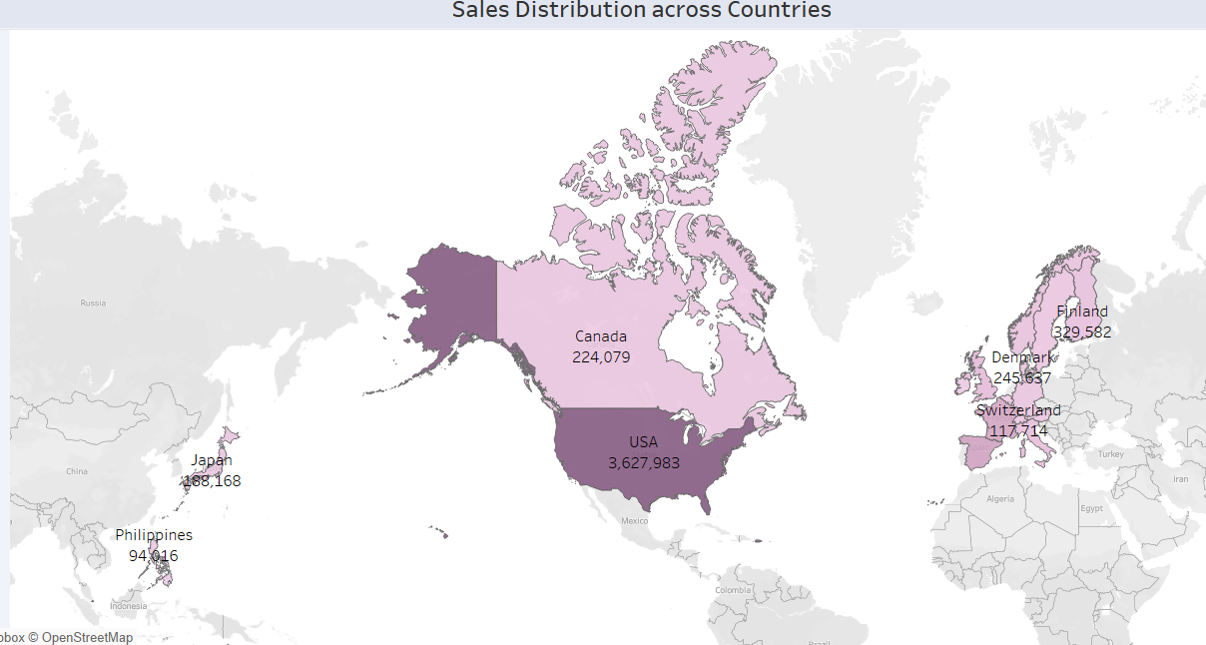
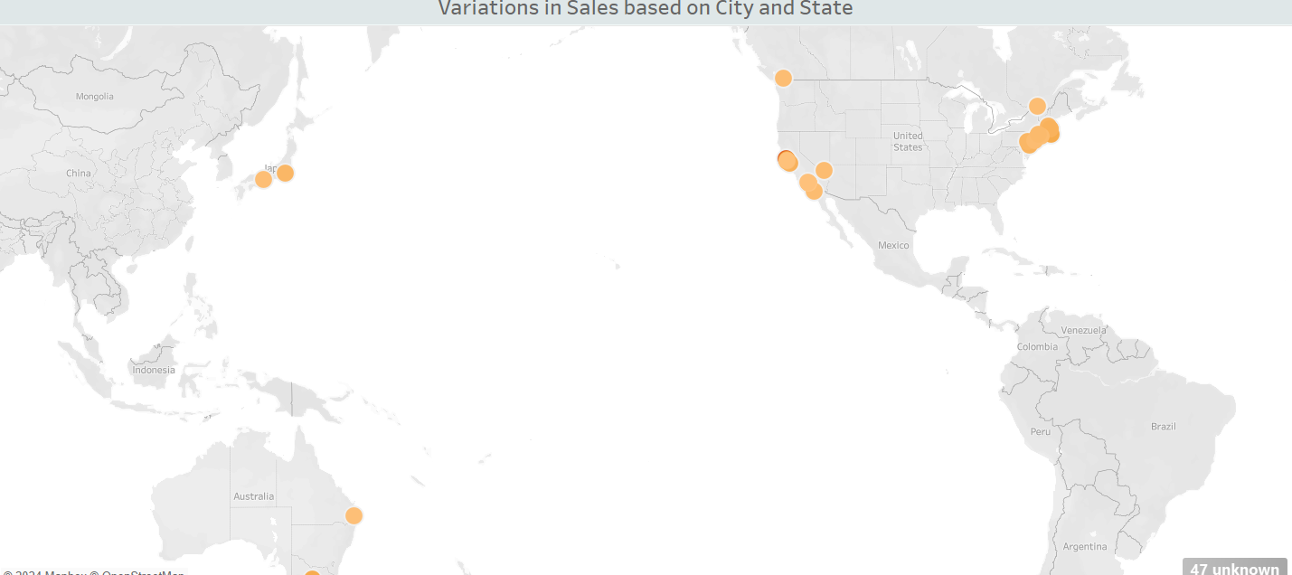
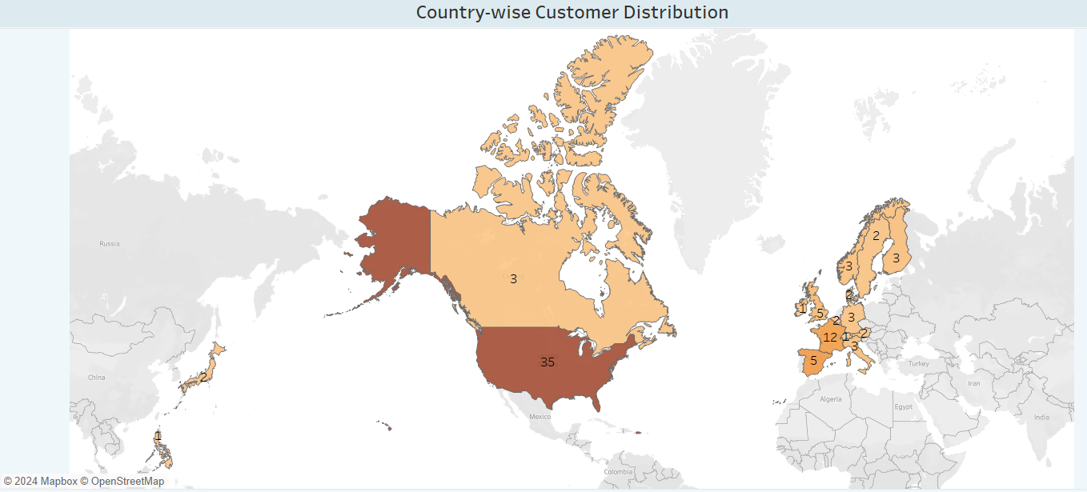
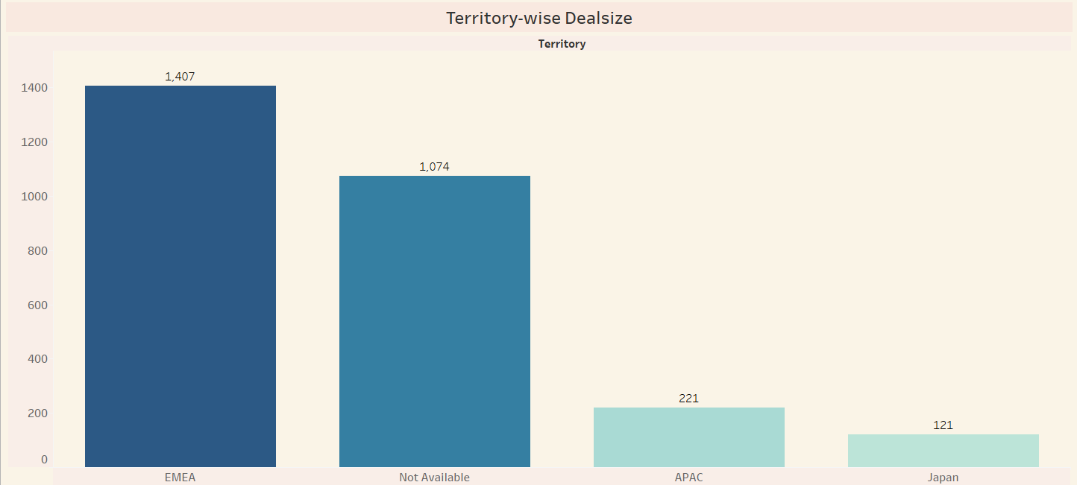
Customer Segmentation:
USA has the highest Total Sales followed by Spain which are in different regions.
The states of California and New York have the highest sales in the region, while San Rafael city has the highest sales of all.
the 3rd map shows that the customer base is primarily concentrated in North America, with a smaller presence in Europe and Canada.
the bar chart reveals that Territory 1 has the largest deal size, followed by Territory 2. Territory 3 and Territory 4 have significantly smaller deal sizes, indicating a concentration of larger deals in specific territories.

Slide 7
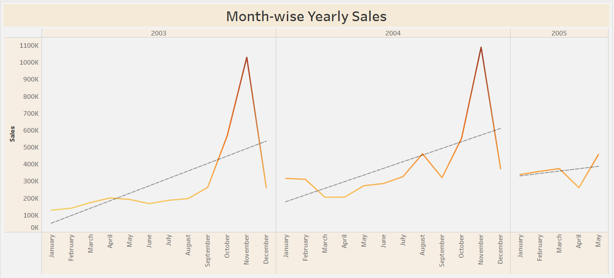
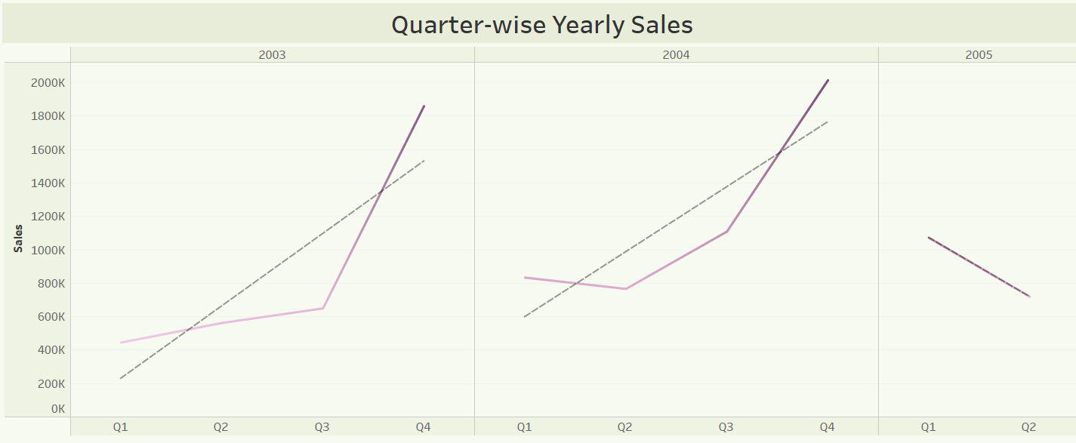
Sales forecasting
* Month_wiseyearly sales:There is a general upward trend in total sales over the years, with some fluctuations within each year.The year 2004 shows the highest overall sales, followed by 2005 and then 2003.
*Quareter-wise yearly sales:There is a general upward trend in total sales over the years and quarters, with an increase in sales from the first quarter of 2003 to the fourth quarter of 2005.

Slide 8
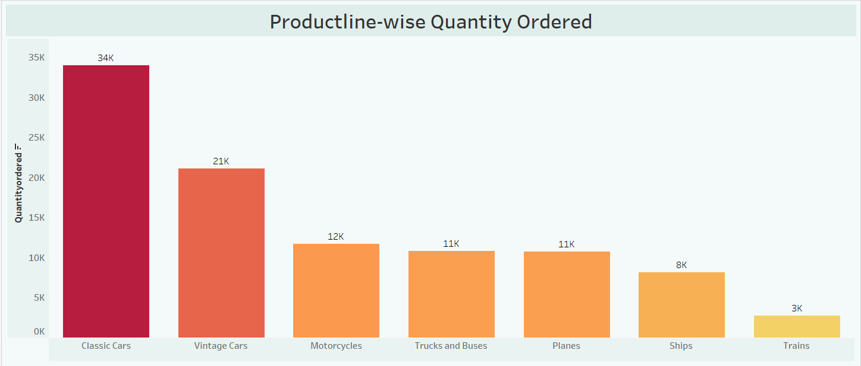
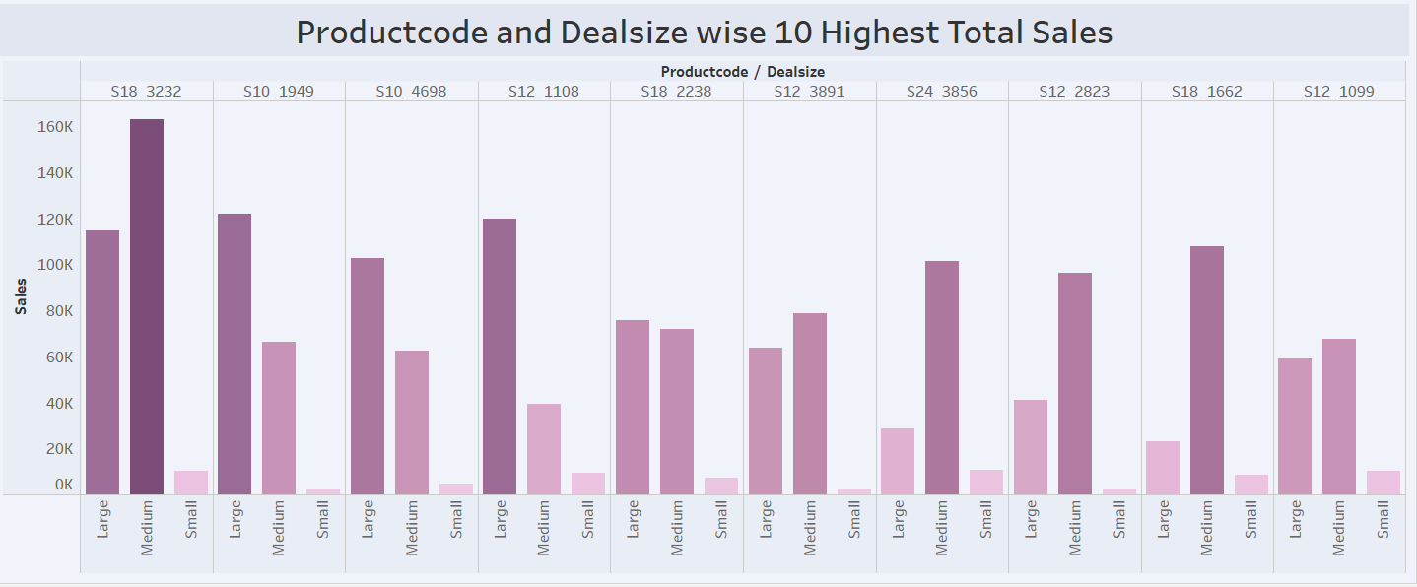
Product Performance
Classic Cars: The "Classic Cars" product line has the highest quantity ordered, with a value of 34,000 units.
Vintage Cars: The "Vintage Cars" product line comes in second with a quantity ordered of 21,000 units.
Motorcycles, Trucks and Buses, Planes: These product lines have similar quantities ordered, ranging from 11,000 to 12,000 units.
Ships and Trains: The "Ships" and "Trains" product lines have the lowest quantities ordered, with 8,000 and 3,000 units, respectively.
Product Code 18_3232: This product code has the highest total sales among all products.
Product Code 512_3891: This product code also has high total sales, ranking second overall.
Other Products: The remaining product codes have varying levels of total sales, with some performing significantly better than others.
Task 4 c-
Productcode S18-3232 is an over performing product while Productcode S24_3969 is an underperforming product.

Slide 9
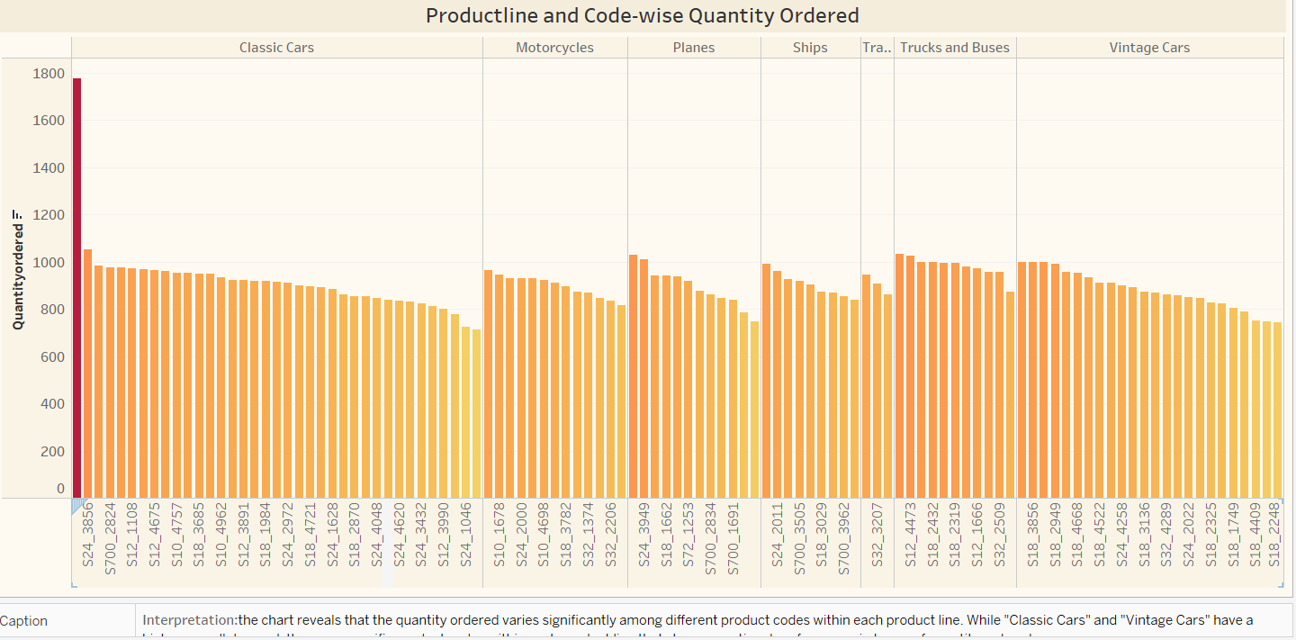
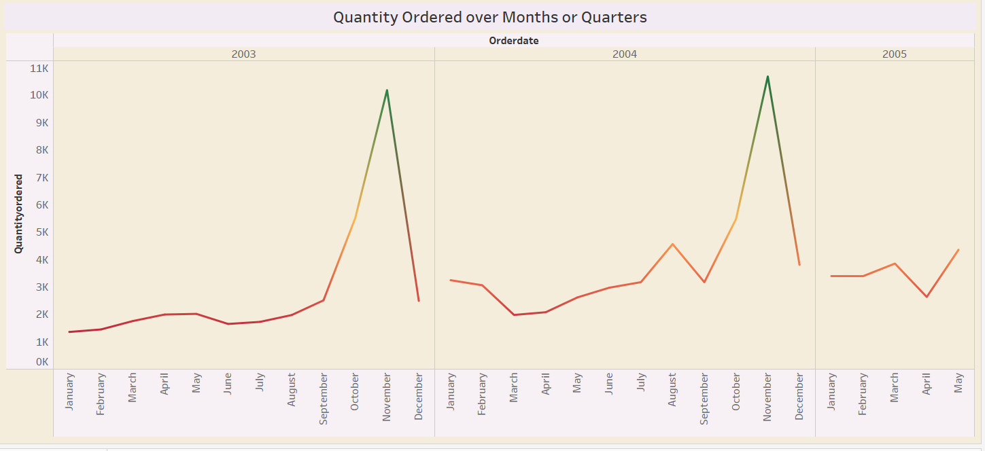
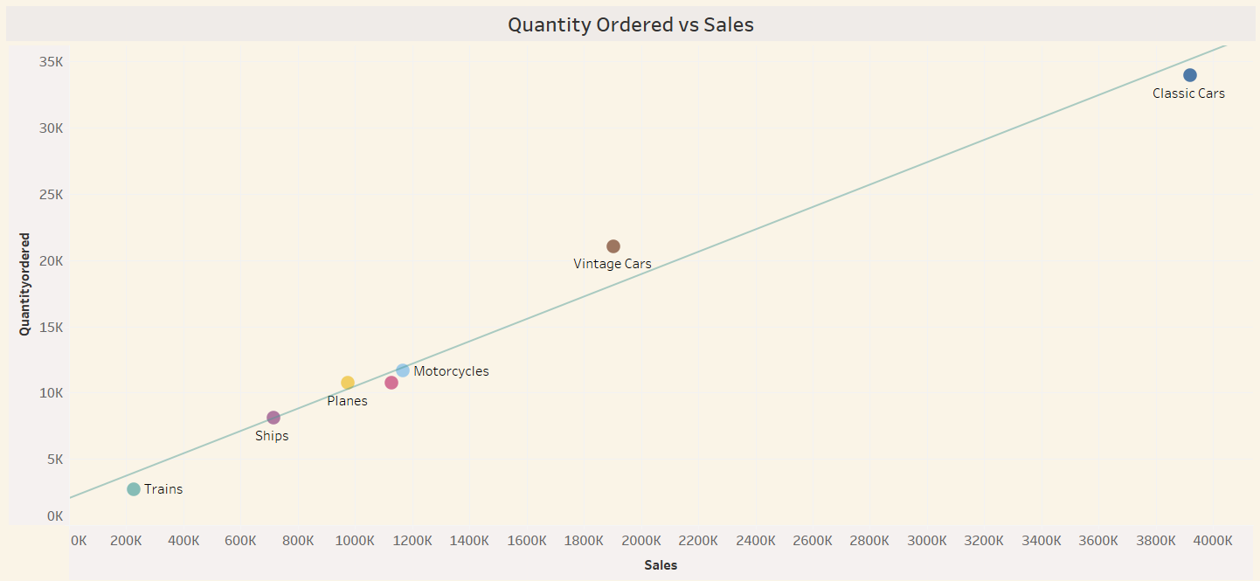
Inventory Management
the 1st chart reveals that the quantity ordered varies significantly among different product codes within each product line. While "Classic Cars" and "Vintage Cars" have a higher overall demand, there are specific product codes within each product line that show exceptional performance in terms of quantity ordered..
There is a general upward trend in quantities ordered over the years, with some fluctuations within each year.
The year 2004 shows the highest overall quantities ordered, followed by 2005 and then 2003.
-There appears to be a general positive correlation between quantity ordered and sales. This suggests that as the quantity ordered for a product line increases, the total sales for that product line also tend to increase.

Slide 10
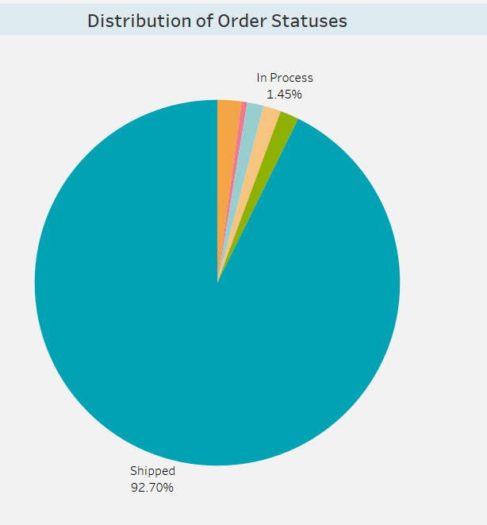
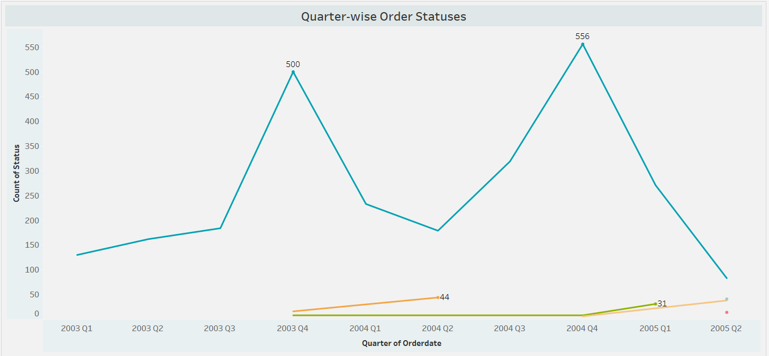
Order Fulfilment Analysis
92.7% of Orders are Shipped.
The number of shipped orders shows a general upward trend over the years, with a significant increase from the first quarter of 2003 to the fourth quarter of 2004.

Slide 11
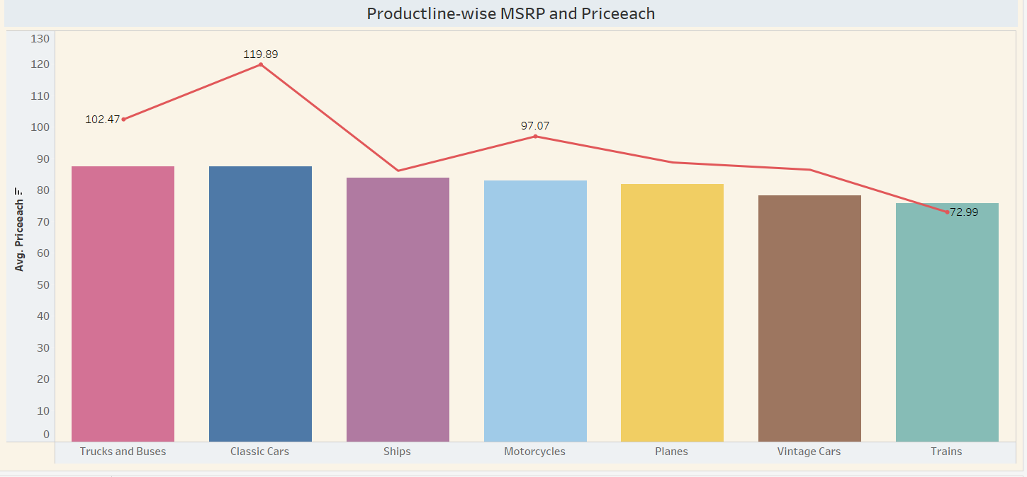
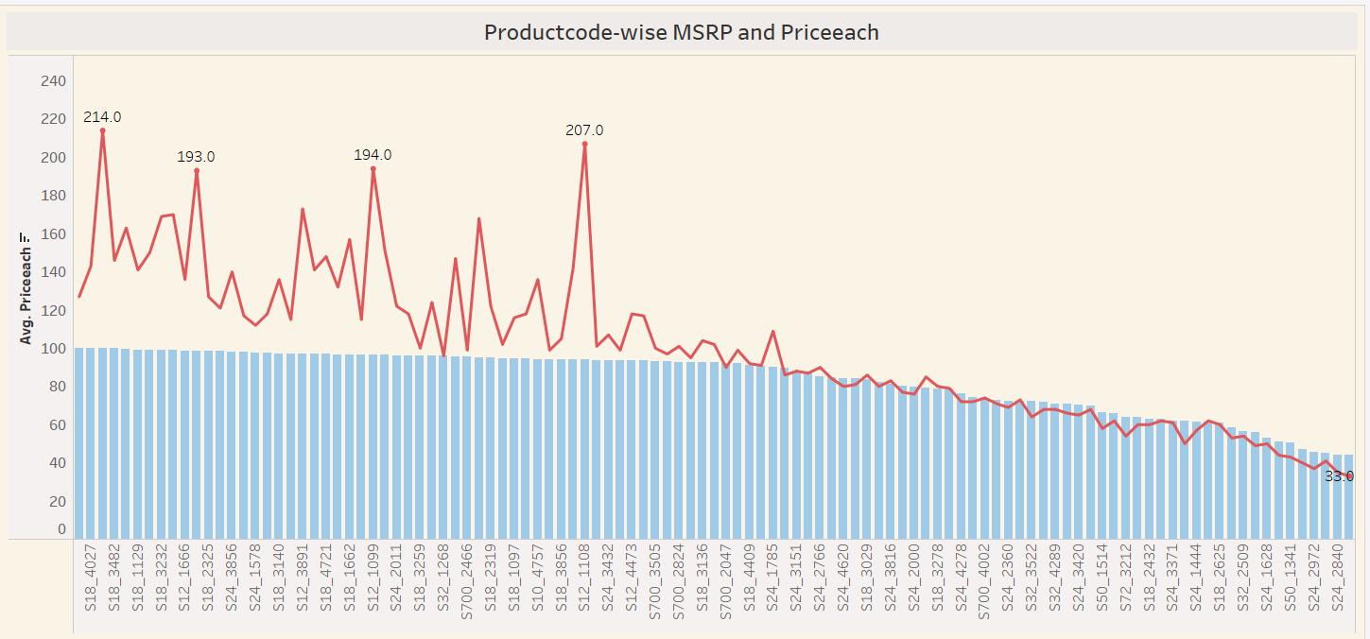
Pricing Strategy
Classic Cars, Trucks and Buses, Motorcycles: For these product lines, the average MSRP is significantly higher than the average price each. This suggests that there might be a significant difference between the suggested retail price and the actual selling price.
There is a general trend where the average MSRP is higher than the average price each for most product codes. This suggests that there might be a significant difference between the suggested retail price and the actual selling price.

Slide 12
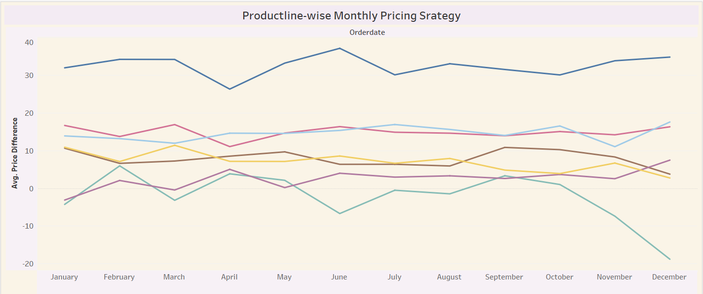
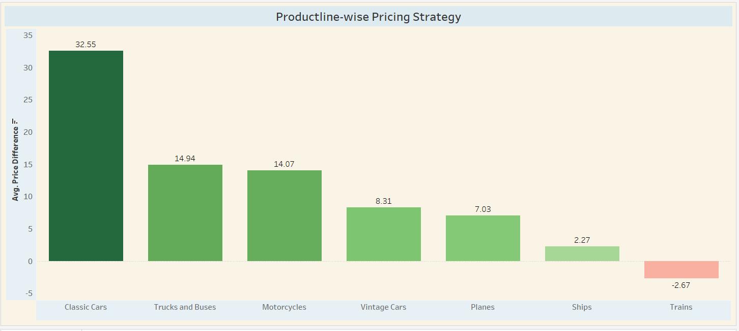
Pricing Strategy(continuation)
Classic Cars: The average price difference for Classic Cars shows a significant increase in June, followed by a gradual decrease towards the end of the year.
Trains: The average price difference for Trains remains relatively low throughout the year, with a noticeable dip in December.
Other Product Lines: The remaining product lines (Trucks and Buses, Ships, Motorcycles, Planes, Vintage Cars) show varying trends in price differences throughout the year. Some product lines exhibit slight increases or decreases, while others remain relatively stable.
The chart reveals that pricing strategies vary significantly across different product lines.
Classic Cars, Trucks and Buses, and Motorcycles have higher average price differences, indicating a potential for higher margins.
Vintage Cars, Planes, Ships, and Trains have lower average price differences, suggesting that they might be sold at more competitive prices or with discounts.

Slide 13
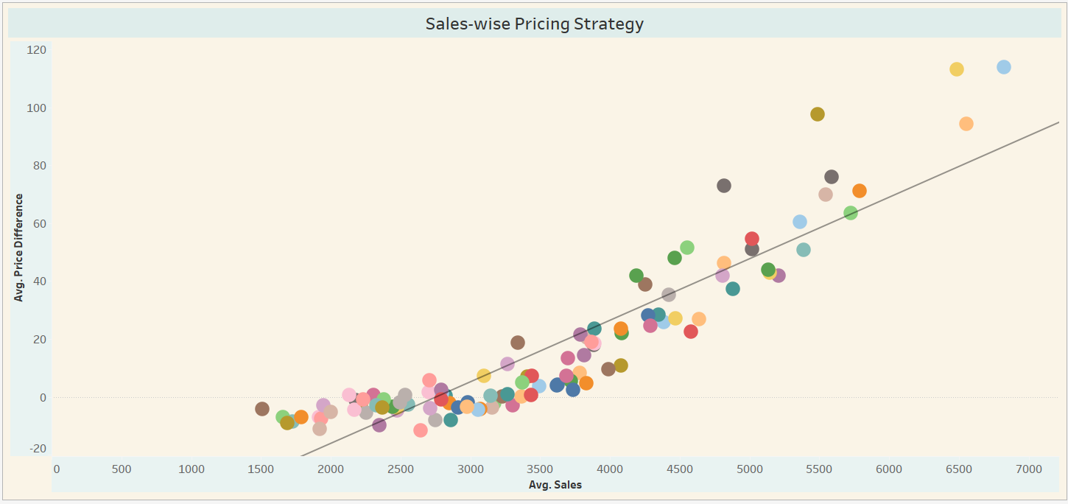
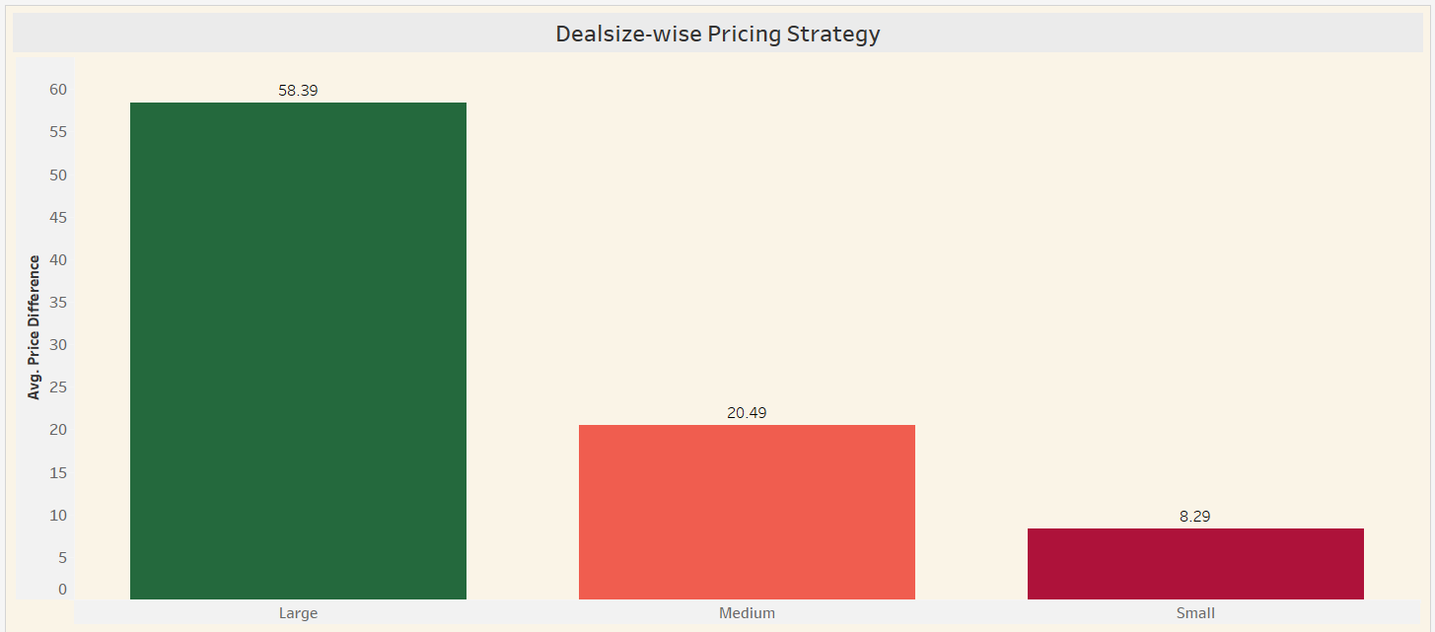
Pricing Strategy(continuation)
There appears to be a general positive correlation between average sales and average price difference. This suggests that products with higher average sales tend to have higher average price differences, indicating a potential markup.
Large Deals: Large deals have the highest average price difference, at 58.39. This suggests that larger deals might have a more significant markup between the suggested retail price and the actual selling price.
Medium Deals: Medium deals have a lower average price difference of 22.49.
Small Deals: Small deals have the lowest average price difference, at 8.29

Slide 14
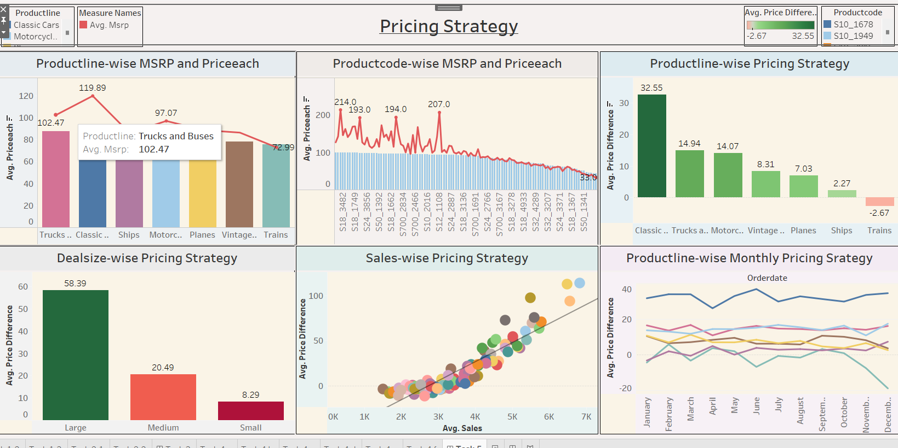

Slide 15
Final conclusion
In this project we find sales analysis,Inventory management,pricing strategy,order fulfilment analysis, product performance, sales forecasting like this…create some visuals in tableau..and create good Dashboards for good understanding the data… In conclusion, this project has shown that there is a strong correlation between automobile sales and the economy.
When the economy is doing well, people are more likely to buy cars.
This is because they have more disposable income and they are more confident about their financial future.
Conversely, when the economy is struggling, people are less likely to buy cars.
This is because they have less disposable income and they are more worried about their financial future.

